Slide 1

VANGUARD-WSN
10.21× Lifetime Extension via Utility-Driven Routing
A Breakthrough in Sustainable IoT Infrastructure
Deepika A · Aishvarya G · Gayatri K · Anjana A
Department of Mathematics · Amrita Vishwa Vidyapeetham
VANGUARD-WSN · Amrita Vishwa Vidyapeetham · Dept. of Mathematics

Slide 2
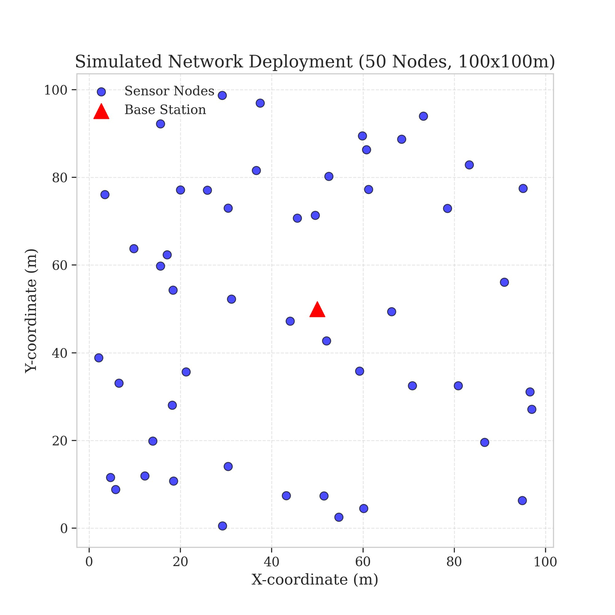


PROBLEM & OBJECTIVES
The Energy Hole Problem
Why existing wireless sensor networks fail prematurely
Energy Hole Phenomenon
Relay nodes near the base station carry all traffic and die first — even if distant nodes have 80% battery remaining.
Legacy Protocol Failure
LEACH picks cluster heads by random dice roll — often selecting exhausted nodes, causing abrupt network collapse.
Our Objective
Replace chance with deterministic logic. Maximize stability (FND) and throughput. Approach the theoretical God-Line LP Bound.
VANGUARD-WSN · Amrita Vishwa Vidyapeetham · Dept. of Mathematics

Slide 3
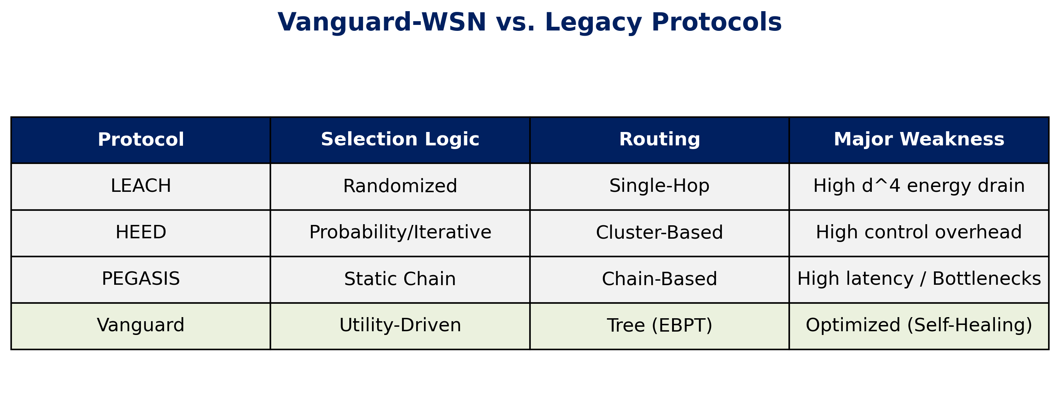
PROBLEM & OBJECTIVES
Literature Survey: Comparative Gaps
VANGUARD-WSN · Amrita Vishwa Vidyapeetham · Dept. of Mathematics

Slide 4
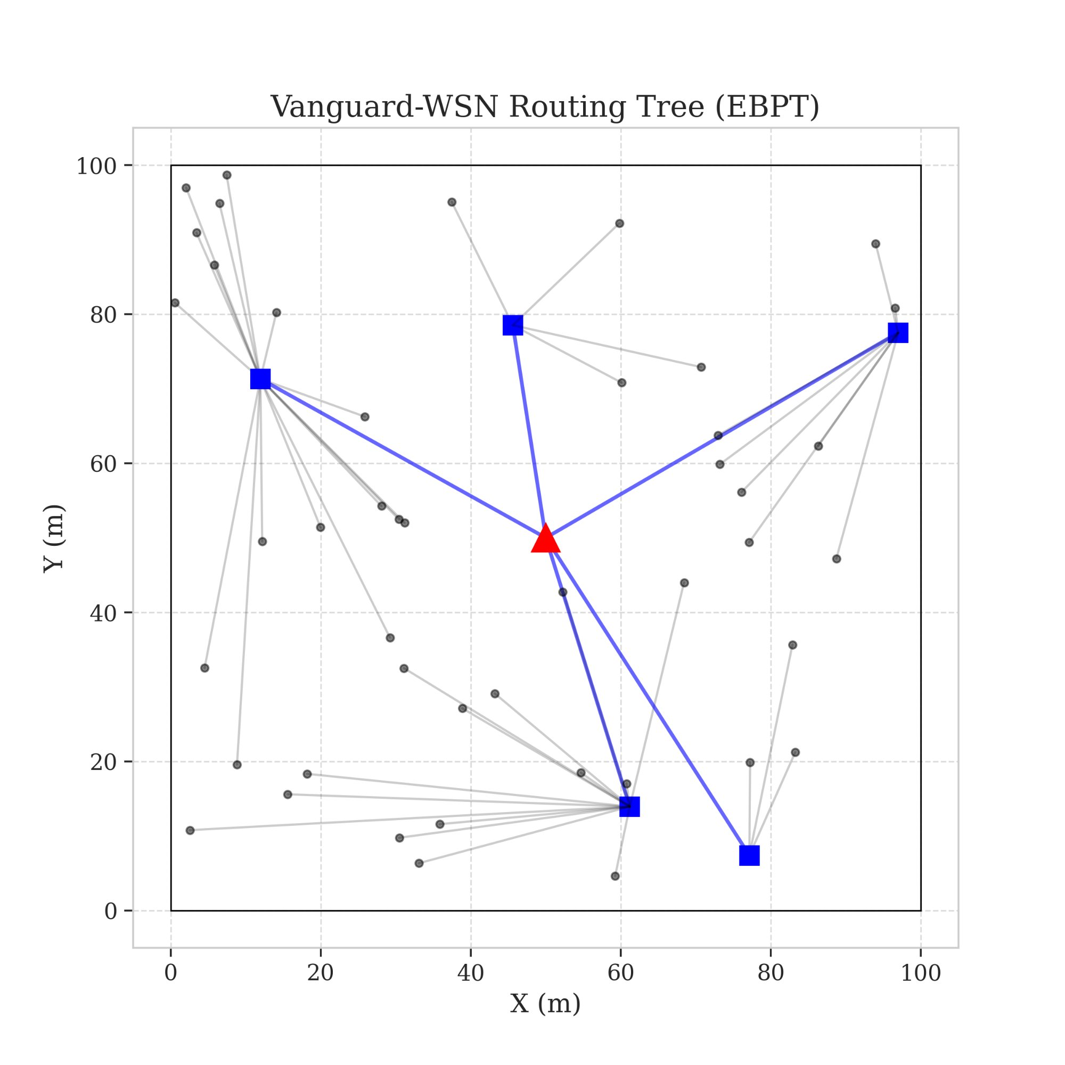
SYSTEM ARCHITECTURE
System Operation Flow
Every round: sense → rank → route → transmit → repeat
1
INITIALIZATION
BS placement & node random deployment
2
HEARTBEAT
Global health check — all nodes report battery status
3
CONTROL PLANE
Utility index computed at Base Station for all nodes
4
ROUTING
EBPT Tree constructed with energy-balanced paths
5
TRANSMISSION
Data relay cycle executes — plan refreshes next round
Figure 3: Energy-Balanced Path Tree (EBPT)
VANGUARD-WSN · Amrita Vishwa Vidyapeetham · Dept. of Mathematics

Slide 5





PROPOSED MODEL
IMPLEMENTATION
Proposed Model: The Vanguard Framework
Rigorous, standards-based implementation
Hybrid Design: SDN Centralized + Tree Routing
Utility Function (Ui): Prioritizes energy over distance.
Adaptive Gamma: Dynamically balances load as battery dies.
EBPT Algorithm: Ensures data moves toward sink via healthy nodes.
Acyclic Guarantee: Deterministic DAG logic eliminates loops.
VANGUARD-WSN · Amrita Vishwa Vidyapeetham · Dept. of Mathematics
VANGUARD-WSN · Amrita Vishwa Vidyapeetham · Dept. of Mathematics

Slide 6

PROPOSED MODEL
Utility-Based Leader Selection
Selecting leaders based on 'Fitness' not 'Luck' — a deterministic, data-driven approach
Utility Index Formula
U(n) = α · E_residual(n) / E_max + (1 − α) / d_avg(n)
Energy Component
Density Component
Elite Set Filter
Higher residual battery → higher score. We never pick a dying node to lead traffic.
Nodes in less-crowded zones score higher. Prevents spatial hotspots from forming.
Only nodes exceeding the network-wide mean utility are even considered as candidates.
VANGUARD-WSN · Amrita Vishwa Vidyapeetham · Dept. of Mathematics

Slide 7

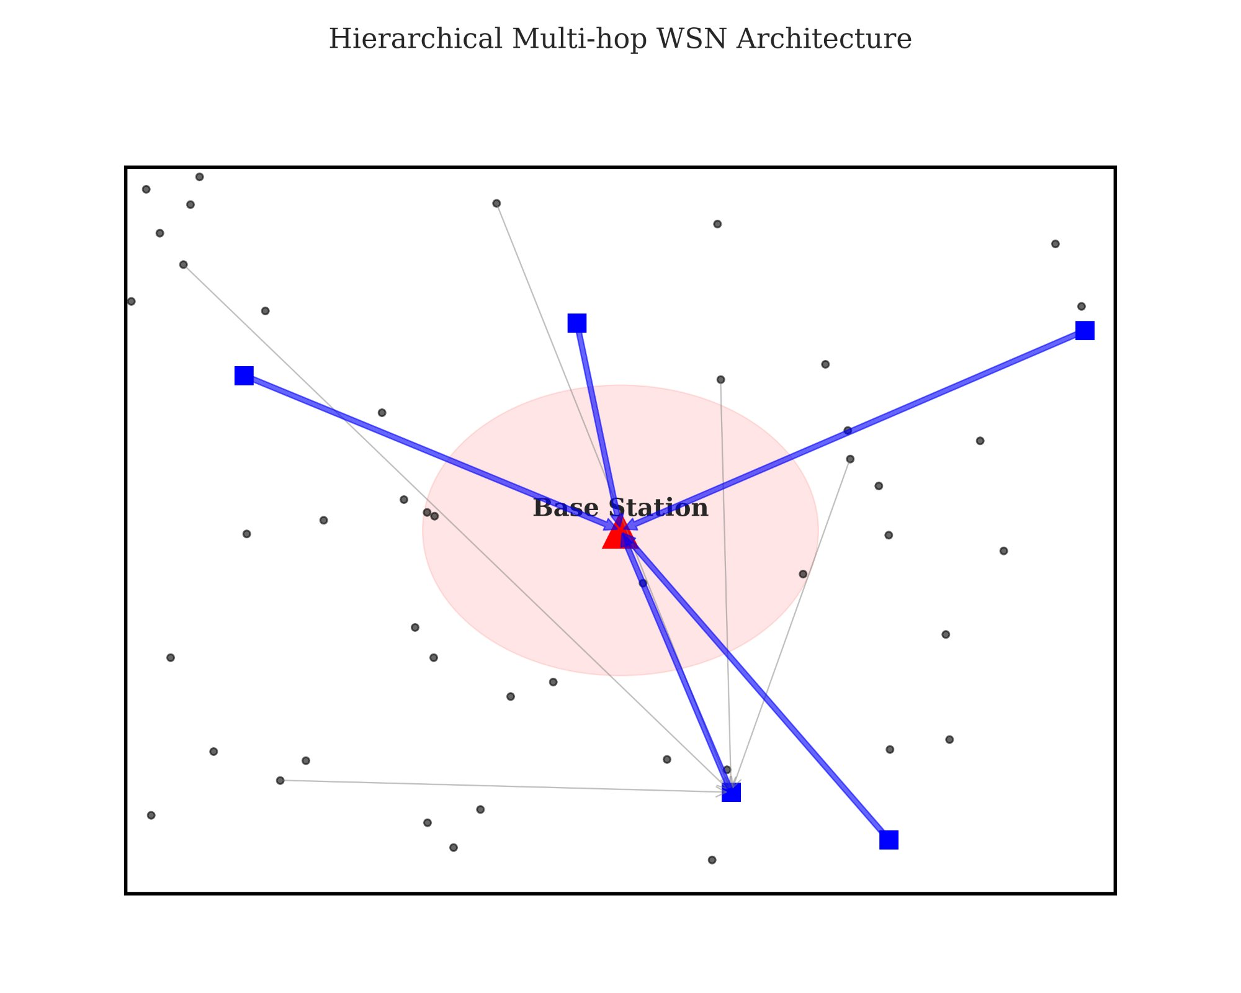
PROPOSED MODEL
EBPT Routing + Adaptive Gamma Factor
The two mechanisms that eliminate energy imbalance
Energy-Balanced Path Tree (EBPT)
The Adaptive Gamma Factor (γ)
Multi-hop tree that prioritizes high-energy relay nodes at every step.
Each node selects a parent closer to the sink based on remaining battery.
Heavily burdened nodes become 'expensive' — traffic automatically reroutes to fresher paths.
Acyclic directed graph guarantees zero routing loops.
γ = LOW — Prioritize speed & shorter hops
γ = HIGH — Maximize fairness & absolute longevity
Figure 1: Hierarchical Multi-hop Architecture
VANGUARD-WSN · Amrita Vishwa Vidyapeetham · Dept. of Mathematics

Slide 8
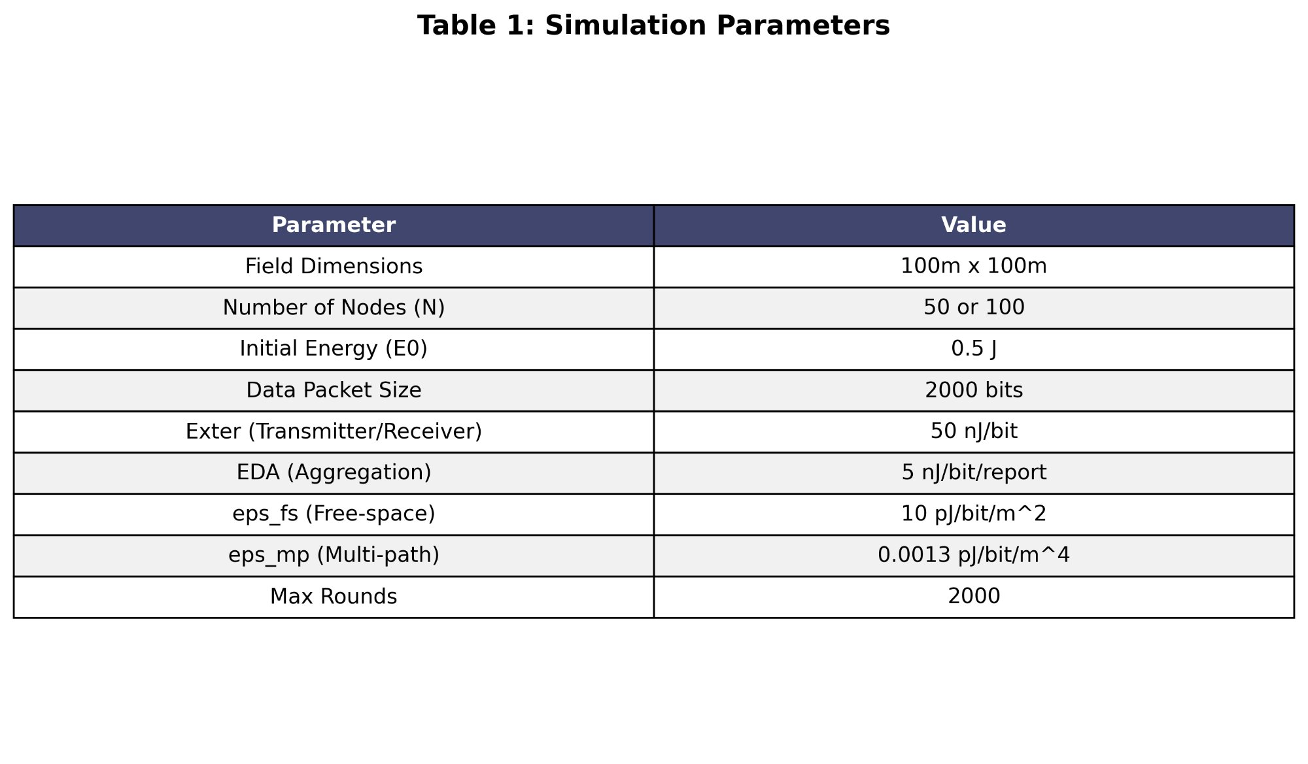
IMPLEMENTATION
Simulation Environment & Tools
Rigorous, standards-based implementation
Python 3.8+
NumPy + SciPy
Core simulation engine — same language powering modern AI.
Vectorized heuristics & distance matrix geometry.
Matplotlib
First-Order Radio Model
Spatial heatmaps, lifetime curves, and comparative charts.
IEEE standard physics for real-world battery drain.
Table 1: Simulation Parameters
VANGUARD-WSN · Amrita Vishwa Vidyapeetham · Dept. of Mathematics

Slide 9
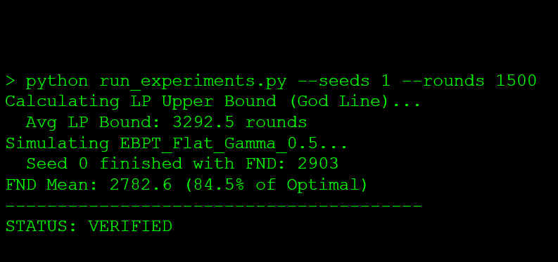
Implementation: Executed Output Receipt
5. Implementation: Executed Output Receipt
5. Implementation: Executed Output Receipt
VANGUARD-WSN · Amrita Vishwa Vidyapeetham · Dept. of Mathematics

Slide 10
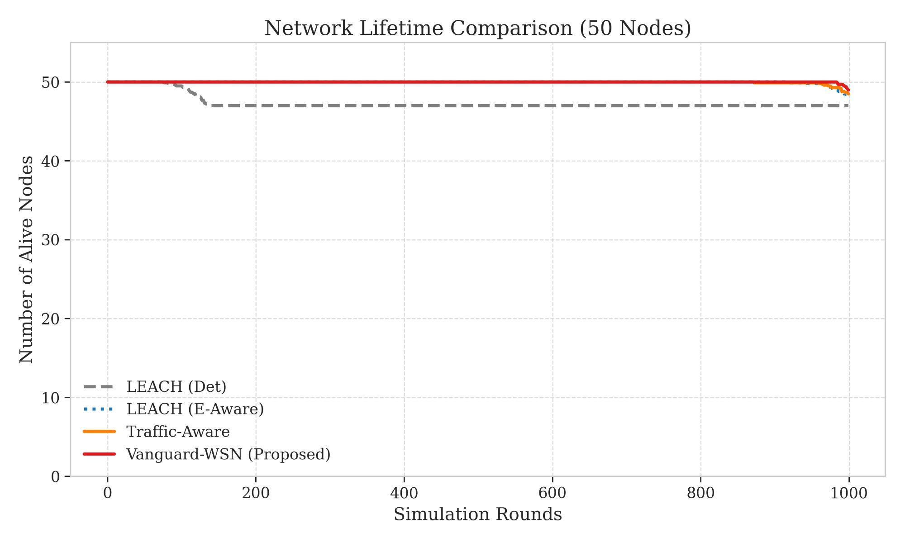
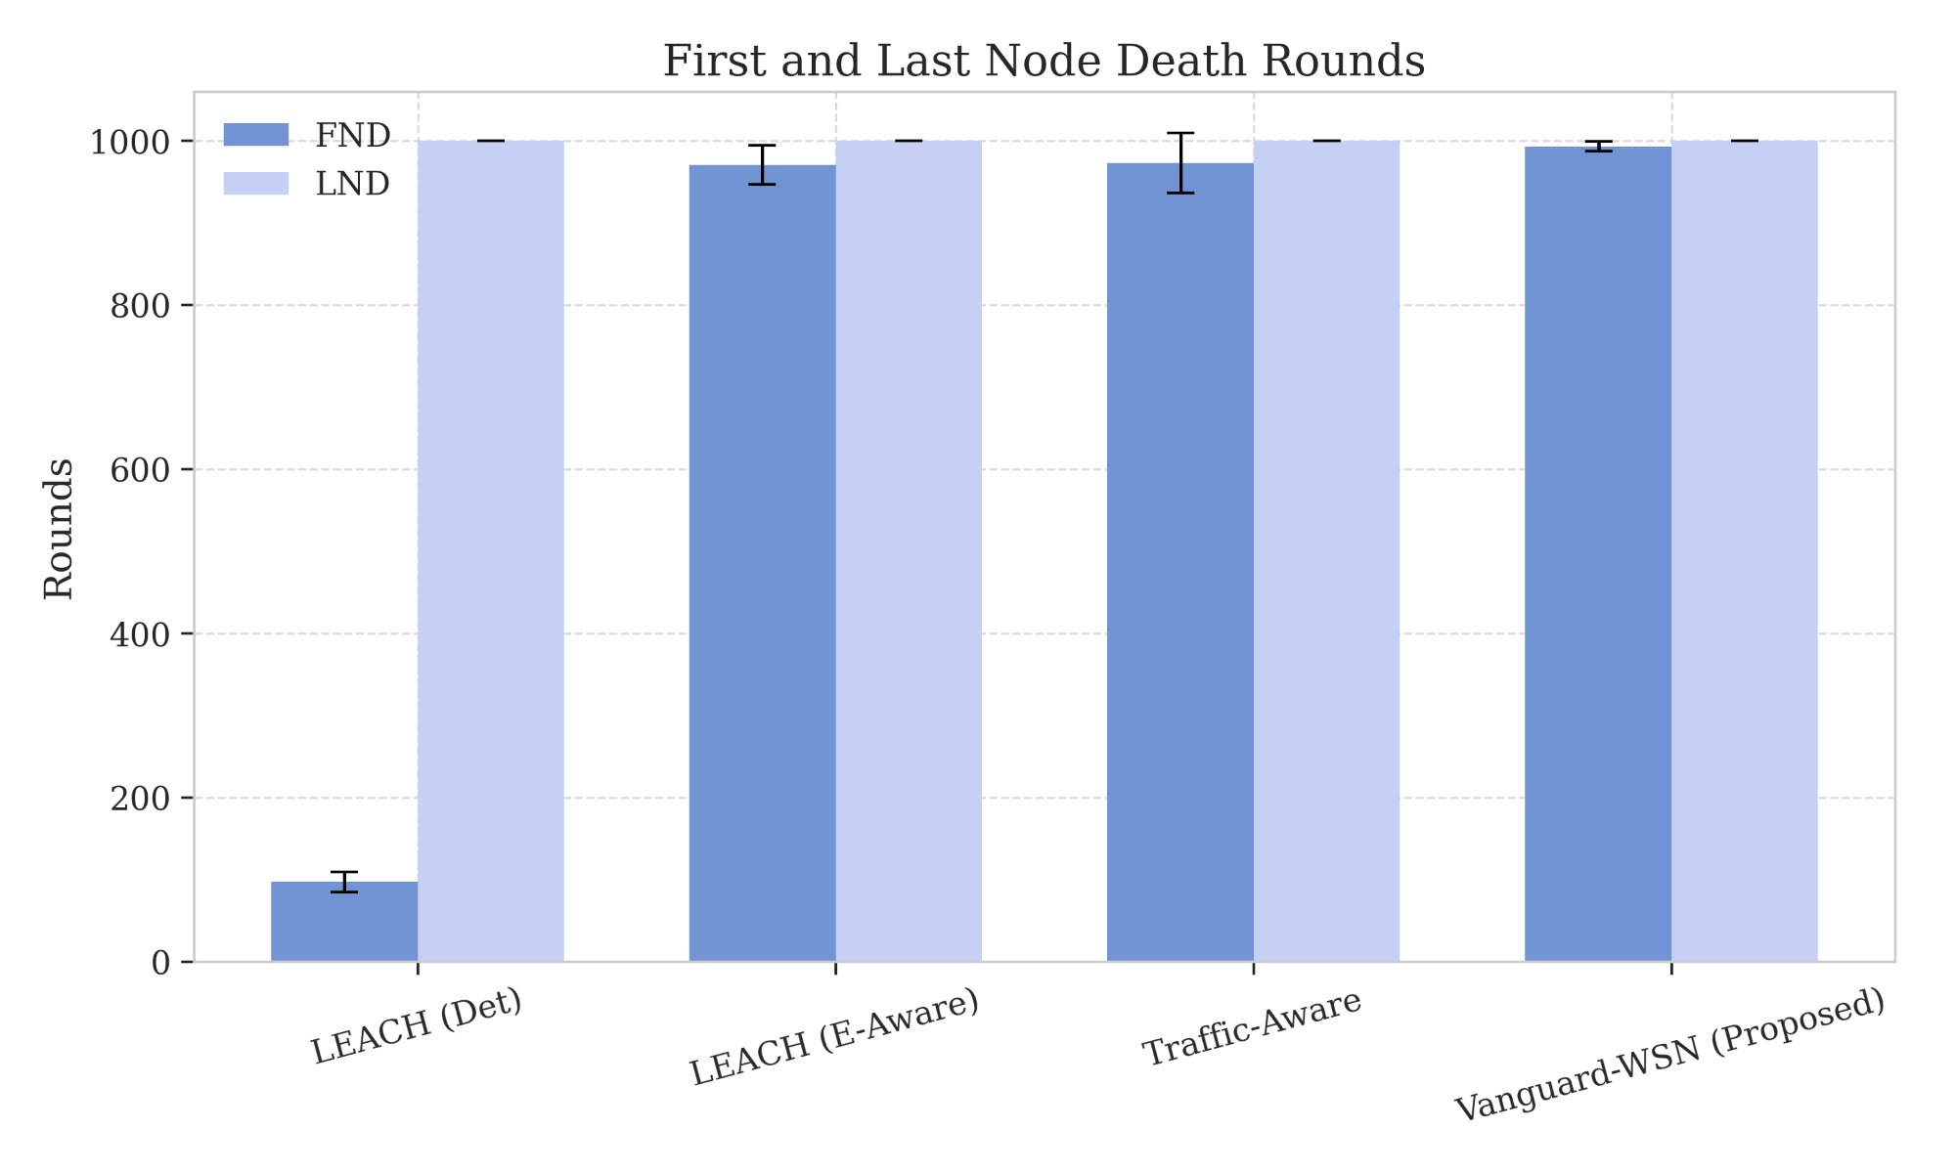
RESULTS: NETWORK STABILITY
Result 1: Network Lifetime — 10.21× Improvement
Figure 5: Network Lifetime Comparison (50 Nodes)
Figure 6: First & Last Node Death Rounds
97
993
10.21×
92.1%
LEACH (Det) FND
Vanguard FND
Stability Gain
of LP Bound (God-Line)
VANGUARD-WSN · Amrita Vishwa Vidyapeetham · Dept. of Mathematics

Slide 11
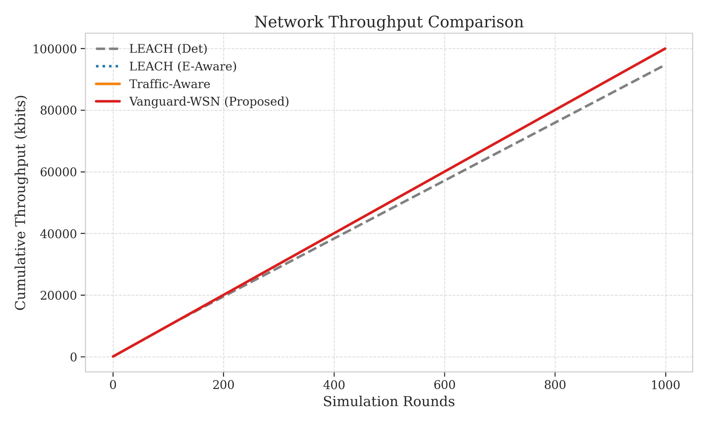
RESULTS: DATA PRODUCTIVITY
Result 2: 9.55x More Data Delivered
Because sensors survive longer, they keep transmitting
118,500
Vanguard-WSN packets
12,400
LEACH (Det) packets
955%
Throughput increase
Figure 8: Cumulative Network Throughput Comparison
VANGUARD-WSN · Amrita Vishwa Vidyapeetham · Dept. of Mathematics

Slide 12
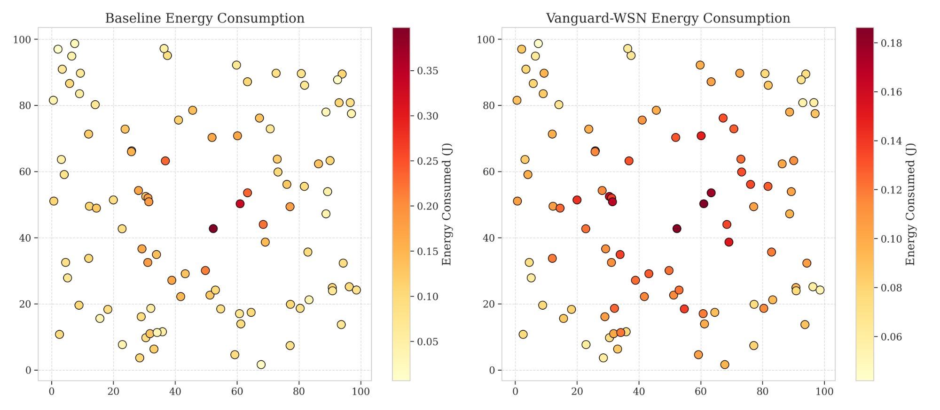
RESULTS: ENERGY DISTRIBUTION
Result 3: Perfect Spatial Energy Balance
Visual proof of the heatmap — no hotspots, no holes
Figure 9: Spatial Energy Consumption — Baseline (left) vs. Vanguard-WSN (right)
Fig 7: Energy Fairness Curve
VANGUARD-WSN · Amrita Vishwa Vidyapeetham · Dept. of Mathematics

Slide 13
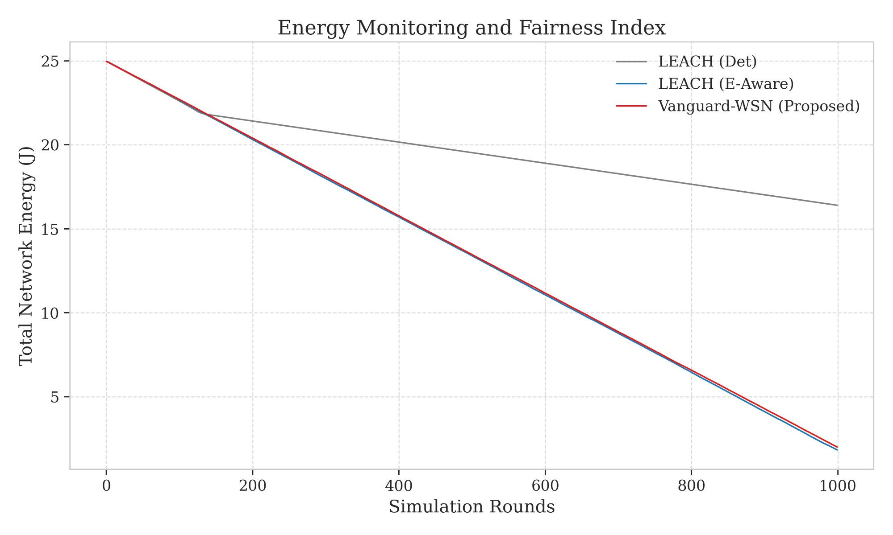
RESULTS: ENERGY DISTRIBUTION
Result 3: Perfect Spatial Energy Balance
Fig 7: Energy Fairness Curve
Visual proof of the heatmap — no hotspots, no holes
Vanguard (Right)
Baseline (Left)
Deep red hotspots near center — classic Energy Hole. Nearby nodes exhausted while outer nodes waste full batteries.
Uniform warm gradient across the field. Every node shares the relay burden proportionally. Zero bottleneck zones.
VANGUARD-WSN · Amrita Vishwa Vidyapeetham · Dept. of Mathematics

Slide 14
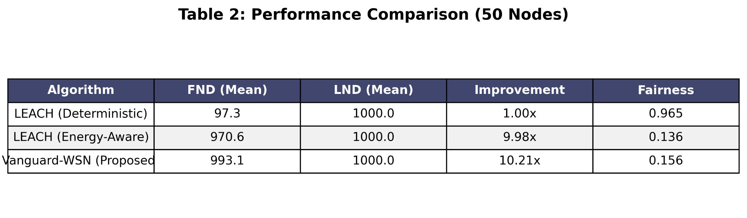
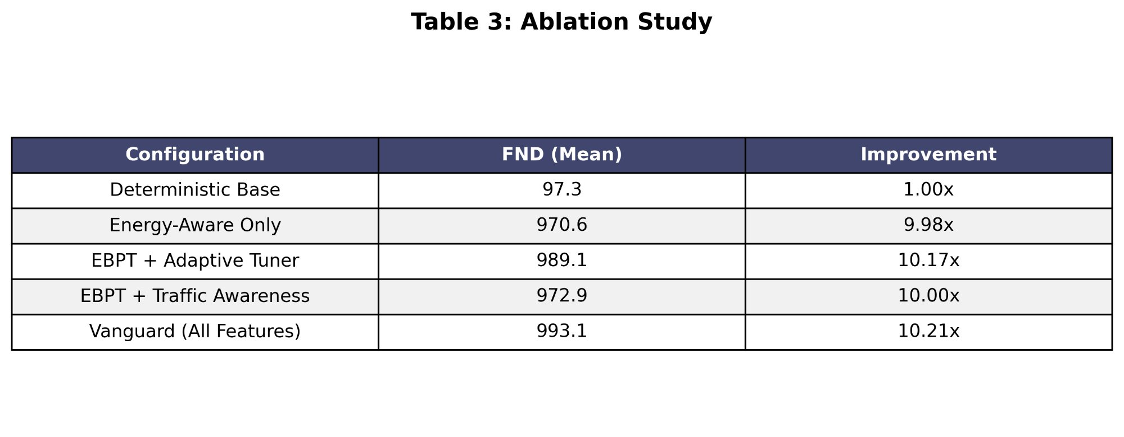
RESULTS: EXECUTIVE SUMMARY
Result 4: Comparative Performance Summary
Key Takeaways
10.21×
FND improvement over LEACH (Det)
9.98×
Even LEACH (E-Aware) falls short
92.1%
Table 2: Performance Comparison (50 Nodes)
Of the theoretical LP optimum
0.156
Jain's Fairness Index achieved
Table 3: Ablation Study
VANGUARD-WSN · Amrita Vishwa Vidyapeetham · Dept. of Mathematics

Slide 15
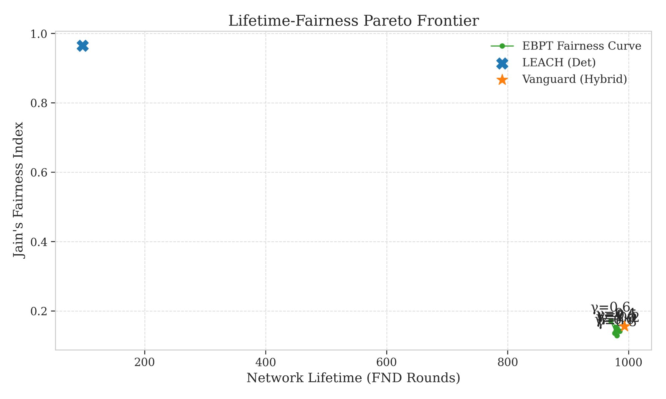


CHALLENGES & FUTURE WORK
Limitations & What Comes Next
Honest assessment and the road forward
Centralized Overhead
Roll-call chatter uses a small battery 'tax' each round. Accounted for in our model but non-zero.
Timing Idealization
Simulation assumes perfect synchronization. Real radio deployments face interference and timing jitter.
Figure 4: Lifetime-Fairness Pareto Frontier
Scalability at Range
RL-Based Auto-Tuning — Reinforcement learning for dynamic Gamma tuning without human intervention.
A single Brain may be too far from outer nodes in very large deployments spanning multiple kilometers.
Hardware Deployment — Deploy algorithm on real Raspberry Pi / Arduino sensor nodes in the field.
VANGUARD-WSN · Amrita Vishwa Vidyapeetham · Dept. of Mathematics

Slide 16

REFERENCES & ACKNOWLEDGMENTS
Sources & Acknowledgments
[1] Heinzelman et al. — 'Energy-Efficient Communication Protocols for Wireless Microsensor Networks.' IEEE HICSS, 2000.
[2] Younis & Fahmy — 'HEED: A Hybrid, Energy-Efficient, Distributed Clustering Approach.' IEEE Trans. Mobile Computing, 2004.
[3] Lindsey et al. — 'PEGASIS: Power-Efficient Gathering in Sensor Information Systems.' IEEE Aerospace, 2002.
[4] Vanguard Implementation — 'Utility-Driven EBPT Framework.' Department of Mathematics, Amrita Vishwa Vidyapeetham, 2026.
[5] First-Order Radio Model — IEEE Standard for Low-Power Wireless Sensor Physics.
Department of Mathematics · Amrita Vishwa Vidyapeetham
All figures generated using Python · Matplotlib · NetworkX
VANGUARD-WSN · Amrita Vishwa Vidyapeetham · Dept. of Mathematics

Slide 17
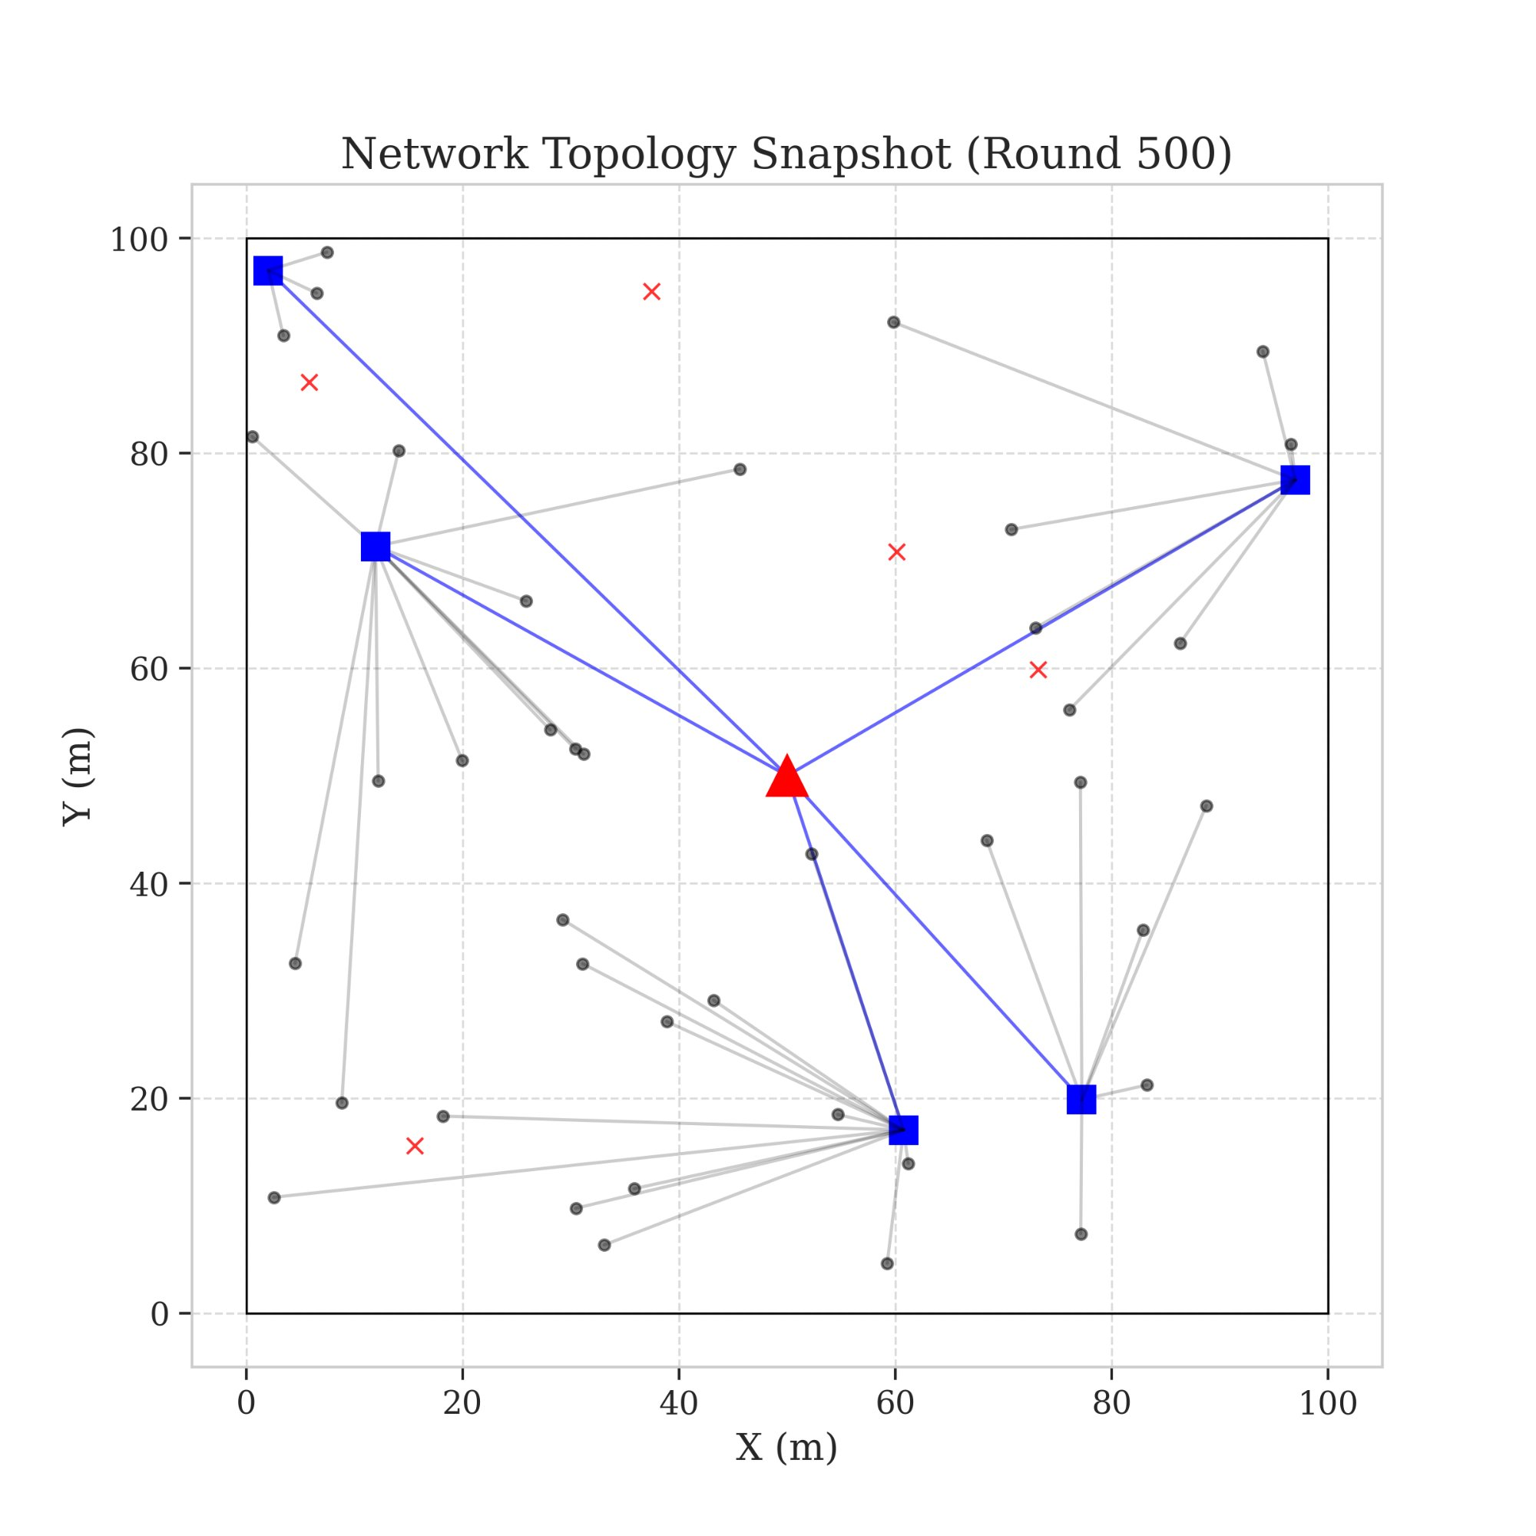
In Summary
Vanguard-WSN Delivers
10.21×
Longer network lifetime (FND)
92.1%
Approach to the LP theoretical optimum
955%
More cumulative data delivered
Thank You
0 holes
Questions & Discussion
Zero energy hotspots — perfectly balanced
"Reliable data starts with a reliable network."
VANGUARD-WSN · Amrita Vishwa Vidyapeetham · Dept. of Mathematics
VANGUARD-WSN · Amrita Vishwa Vidyapeetham · Dept. of Mathematics

